Slide 1
Building
Bob Schultz
Vision One Credit Union
BSchultz@visionone.org
Mark Wright, O.D.
Practice Management Center
MarkWright@optometrybusiness.com

Slide 2
Wealth Building
1) What do you need to retire? Years from now .... 5 .... 40
Calculator
Website
2) How do you get there?
Personal Wealth Building (What do you do with the cash you get from the practice?)
Practice Wealth Building (What do you do to build the practice to make it more valuable)?
What is EBITDA
3) What Action Plan are you going to take today?

Slide 3
What do you need to retire? Years from now .... 5 .... 40
Are you on the correct time schedule?
Are you on the correct path?

Slide 4
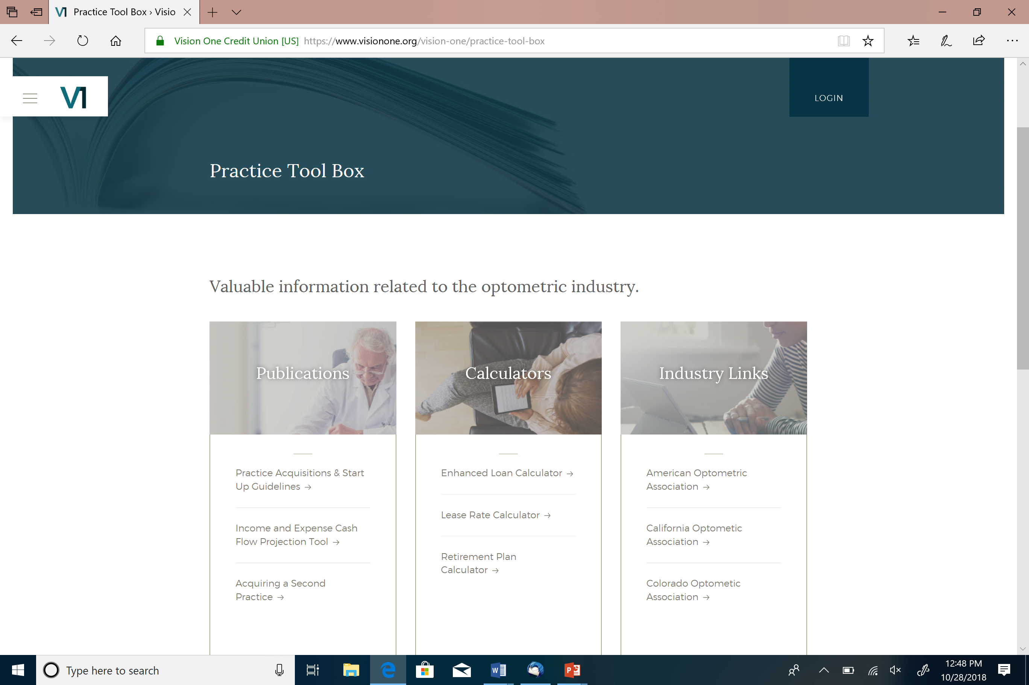

Slide 5
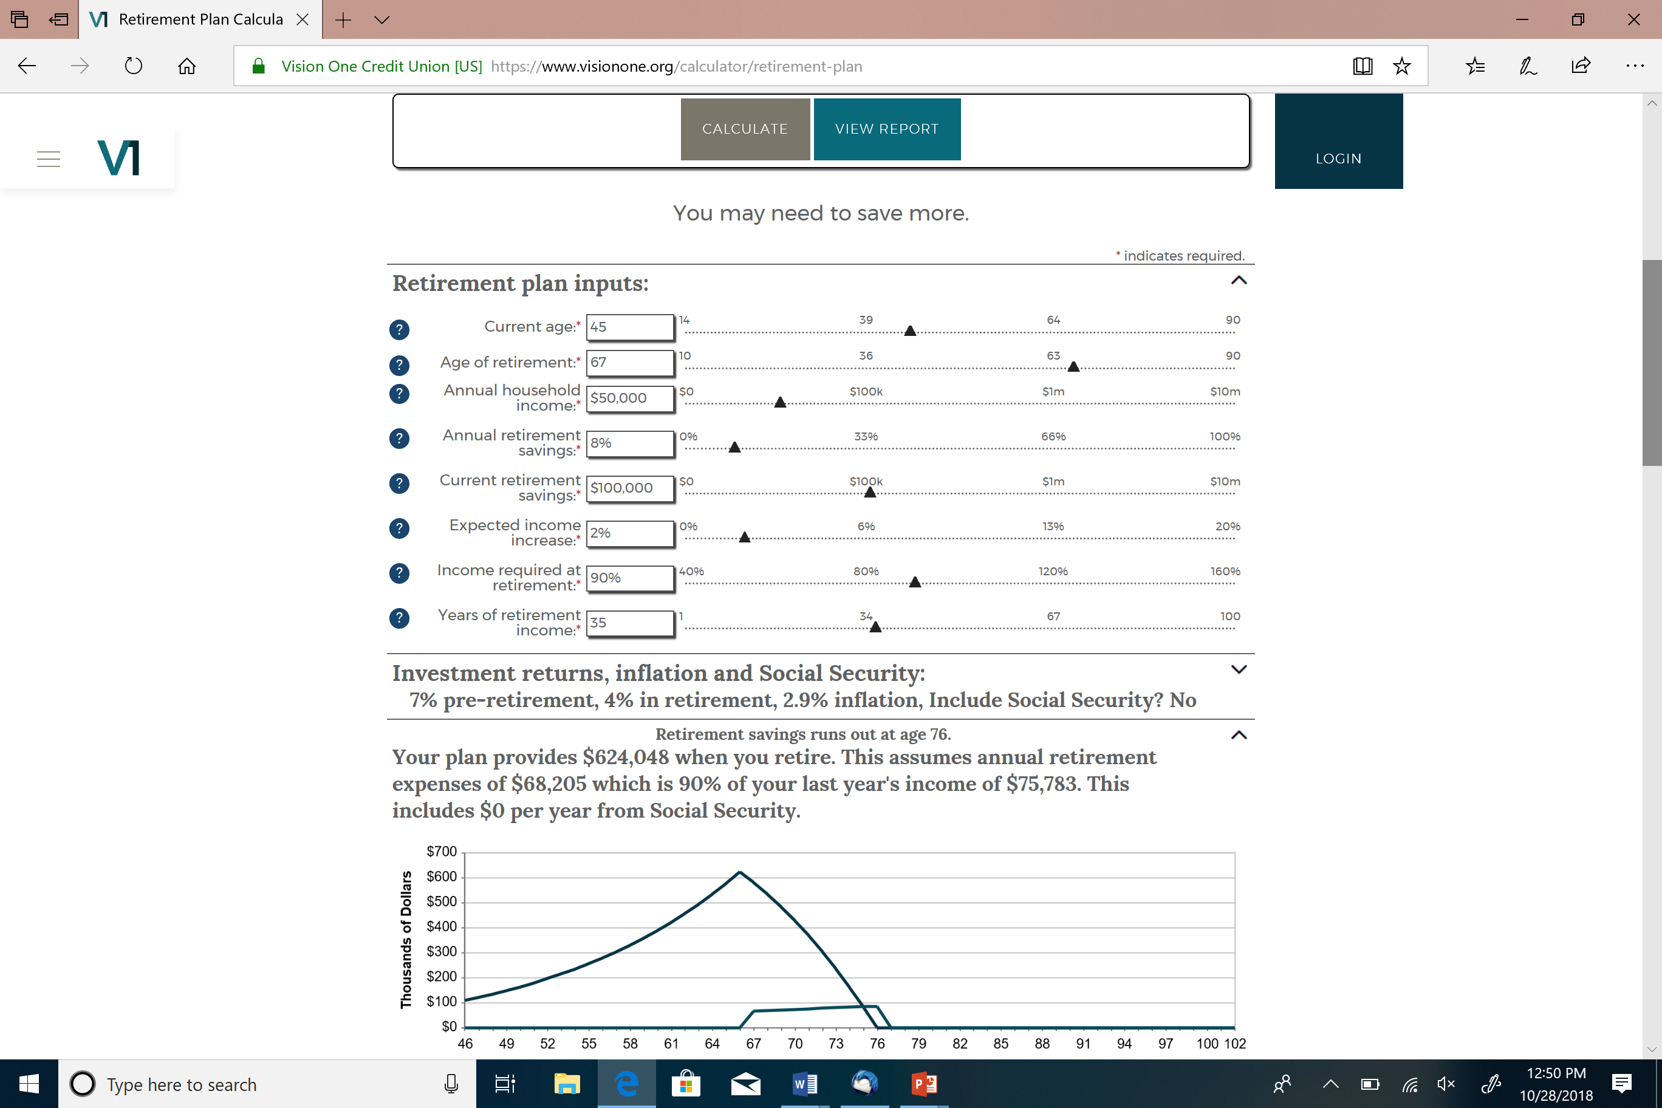

Slide 6
AGE 65
Income | $50,000 | $100,000 | $150,000 | $250,000
You should have | $750,000 | $1,500,000 | $2,250,000 | $3,750,000
With Social Security | $475,000 | $1,000,000 | $1,650,000 | $3,100,000
Reduction with SS | 37% | 33% | 27% | 17%
Assumptions: replace 80% income; 25-year retirement; 5% return; 2.5% inflation Information contained herein was obtained from an interactive calculator, which is available to you as a self-help tool for your independent use and is not intended to provide investment advice. We cannot and do not guarantee their applicability or accuracy in regards to your individual circumstances. All examples are hypothetical and are for illustrative purposes. We encourage you to seek persohalized advice from qualified professionals regarding all personal finance issues.

Slide 7
Personal Wealth Building
How do you get there?

Slide 8
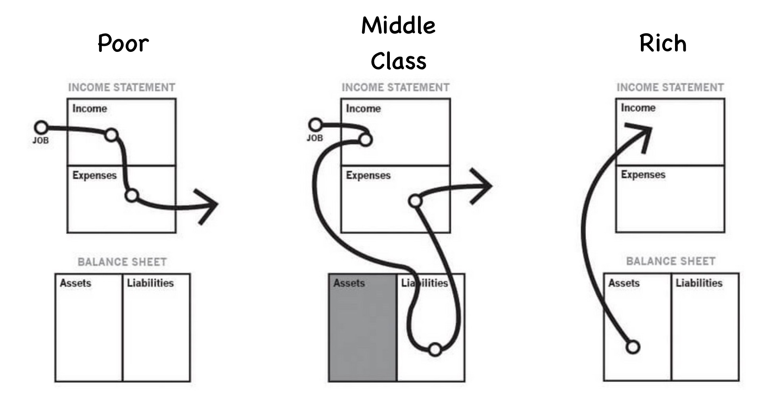

Slide 9
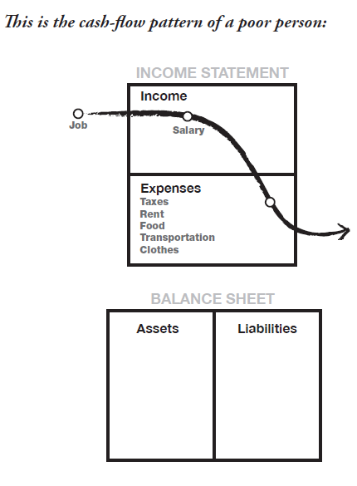
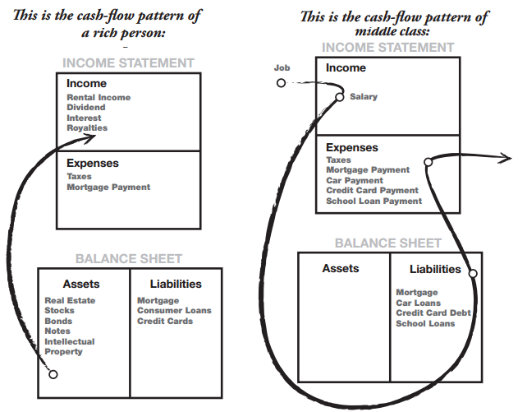
Let’s put some detail to the charts

Slide 10
When your PASSIVE INCOME meets or exceeds your EXPENSES

Slide 11
ACTIVE Income
PASSIVE Income
TOTAL Income
+ =
Investments
Real Estate
Businesses
Stocks & Bonds
Other

Slide 12
FIRE financially independent, retire early
1

Slide 13
FIRE
Earn a good income
Income is not the primary obstacle to early retirement
The biggest obstacle is spending
Save 50% or more of income
Live frugally for the first five years of professional life
Max out retirement accounts
Invest wisely
Utilize low-cost index funds (Vanguard, Fidelity)
Create a diversified investment portfolio

Slide 14
Mr. Money Mustache
How frugal can you live ($25,000)
White Coat Investor
Middle ground
Passive Income M.D.
Maximize your passive income investments
Track expenses
Connect spending with time
mrmoneymustache.com whitecoatinvestor.com passiveincomemd.com

Slide 15
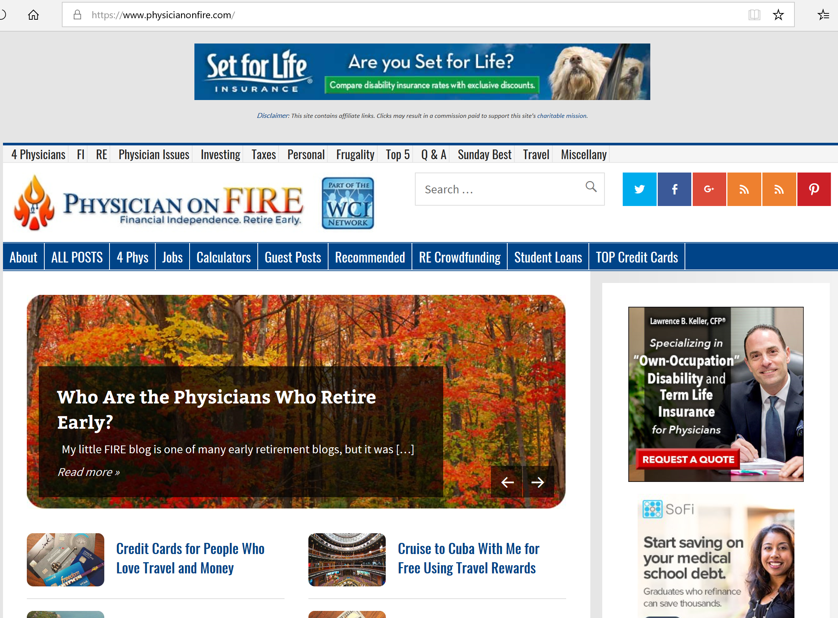

Slide 17
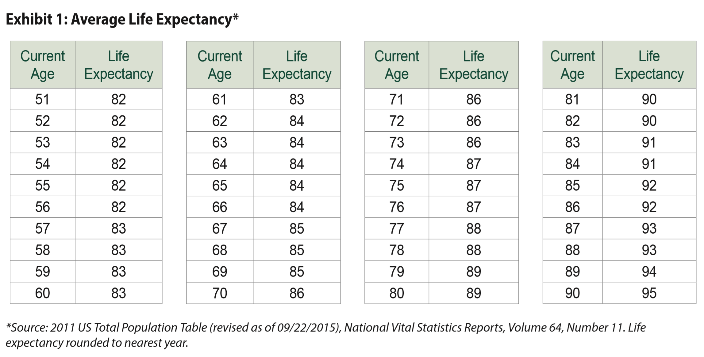
What is your time horizon?

Slide 19
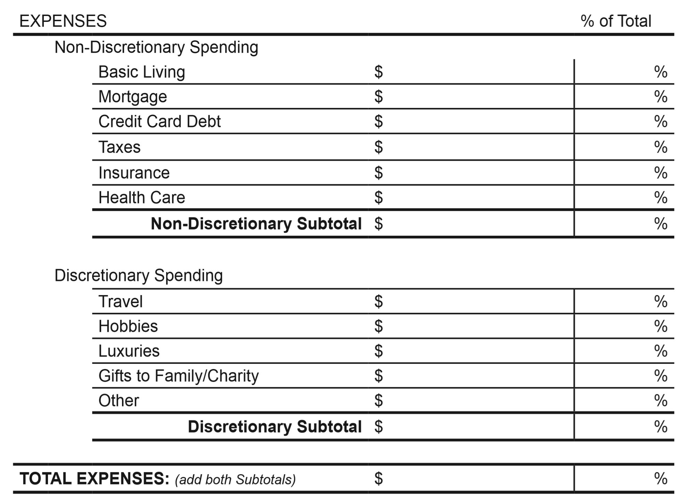

Slide 21
Practice Wealth Building
How do you get there?

Slide 22
Reality Check (GAP Analysis)
Calculate your personal net worth (after tax)
Determine income needed in retirement (inflation adjusted)
Determine the size of the retirement fund needed to support the required income
Calculate the GAP between your retirement fund target and your current net worth
How many years to retirement? Time to build additional wealth
Create a plan to cover the GAP

Slide 23
The Practice is the Driver of all Wealth for an OD

Slide 25
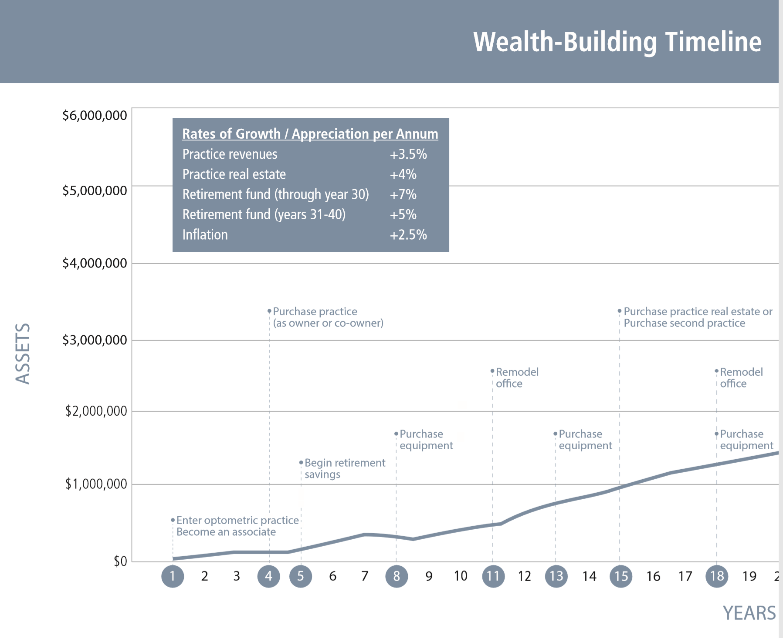
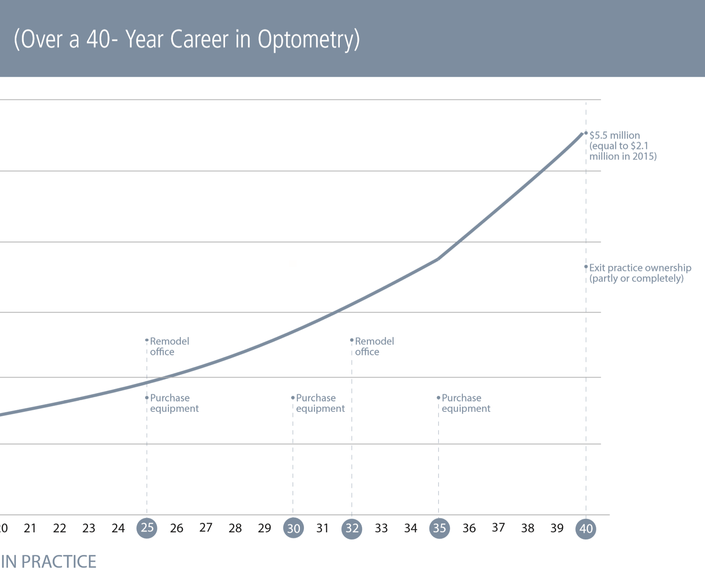

Slide 26
Gross Profit
EBITDA
Net
Optometric Net
True Net
Practice Efficiency
Doctor Effectiveness
S

Slide 27
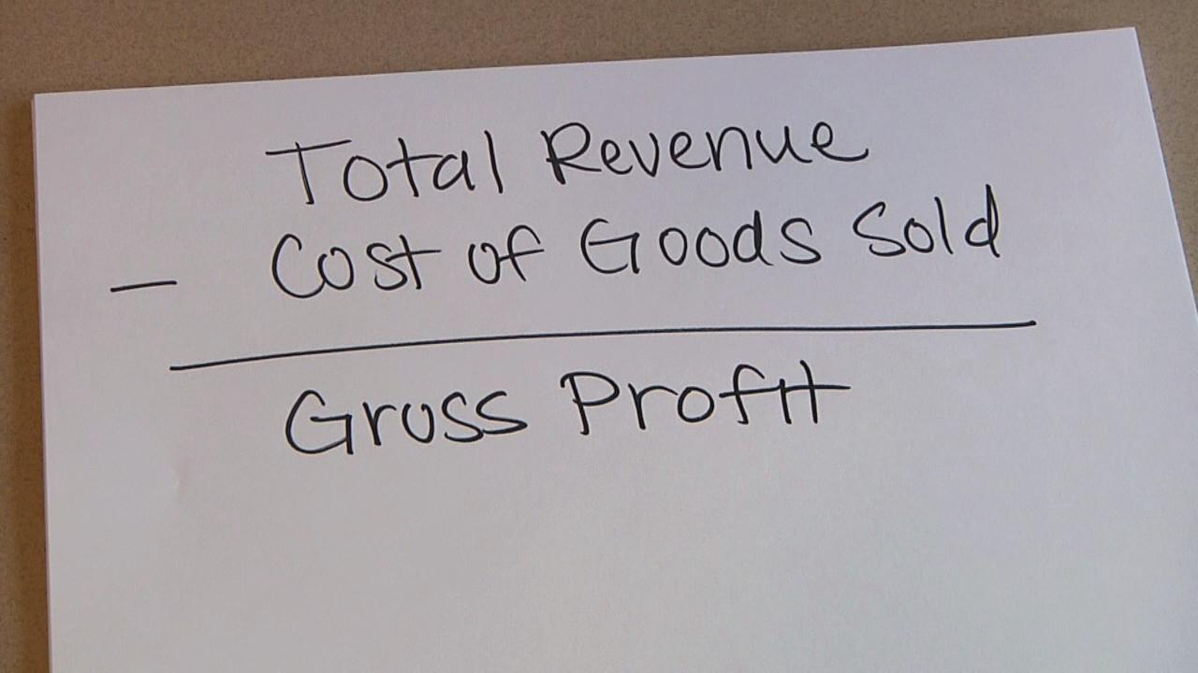

Slide 28
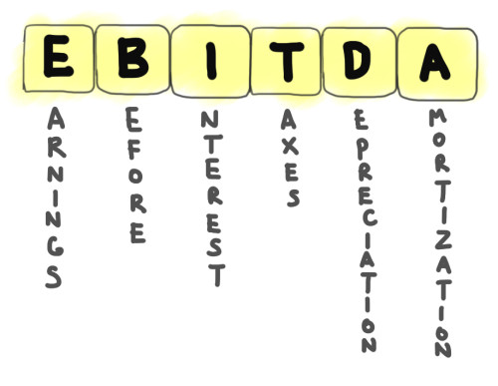

Slide 29
What does NET mean?
Revenue
Expenses
Net
Revenue
Expenses
OD Expenses
True Net
Revenue
Expenses
OD Net
OD Expenses
_
_
_

Slide 30
2 Numbers that impact Practice Valuation
PRACTICE EFFICIENCY
DOCTOR EFFECTIVENESS
29%
$700,000

Slide 31
Return on Investment – Associate OD

Slide 35
Go to Excel Spreadsheet

Slide 38
Bob Schultz
Vision One Credit Union
Mark Wright, O.D.
Practice Management Center

